Slide 1
University of Cincinnati Aerocats
UFB Presentation
03/27/2014

Slide 2
Mission
AeroCats is an AIC group that designs, builds, flies, and competes RC airplanes
The planes are rigorously designed and built and are consistently competitive at national competitions
2013 Micro Class – 2nd Place
2011 Regular Class – 1st Place
2010 Micro Class – 2nd Place
2 teams every year
Advanced and Regular this year

Slide 3
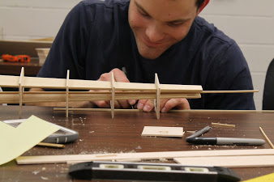
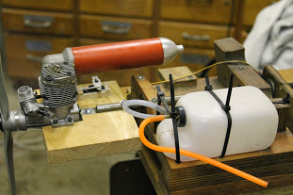
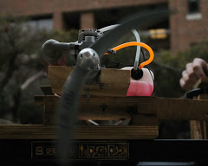
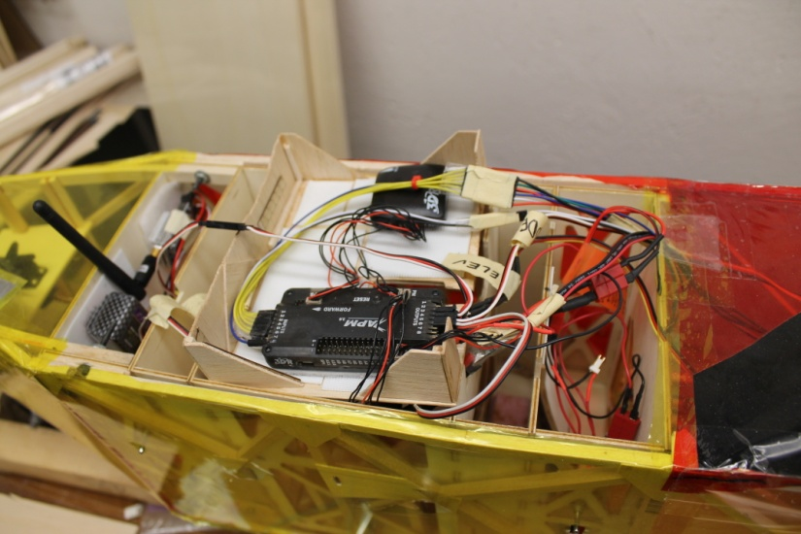
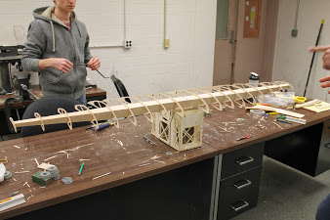
Aircraft Development

Slide 4

Structural Testing

Slide 5
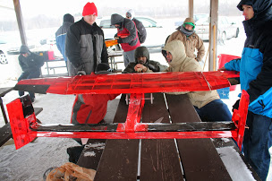
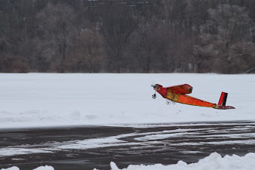
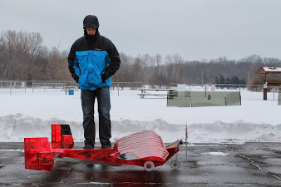
Flight Testing

Slide 6
Flight Testing

Slide 7
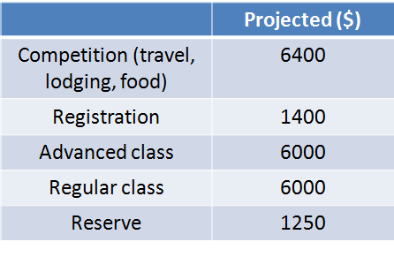
Allotment of Funds

Slide 8
Material Expenses to Date
 | Cost
Wood: | $ 1,681.27
Avionics | $ 2,968.69
Propulsion | $ 2,531.15
Landing Gear, Structures, etc | $ 1,657.56
Equipment | $ 1,500.00
Total | $ 10,338.67

Slide 9
Competition Expenses
 | Cost ($)
Registration for 2 teams | 1400
Lodging | 2000
Transportation | 5500

Slide 10
Total Cost
 | Cost ($)
Materials | 10,400
Registration for 2 teams | 1,400
Lodging | 2,000
Transportation | 3,500
Team Uniforms | 500
Total = $19,800

Slide 11
Funding Sources
Source | Amount
UFB | $8,000
2013-14 Sponsors | $8,250
2012-13 Sponsors | $5,500
Total | $21,750

Slide 12
Summary
AeroCats provides great exposure for UC and allows students to gain hands-on experience as undergrads
Only possible through UFB and corporate sponsors
Team expects to have less than $1,000 by the time the competition has finished

